Slide 1
Stat- 581
Probability and Statistical Inference for Data science
Team Members:
Keya Desai (kd706)
Prakruti Joshi (phj15)
Twisha Naik (tn268)

Slide 2
Goal
Classify whether a given tumor (breast mass) is malignant (cancerous) or benign (non-cancerous) based on different properties of the tumor.

Slide 3
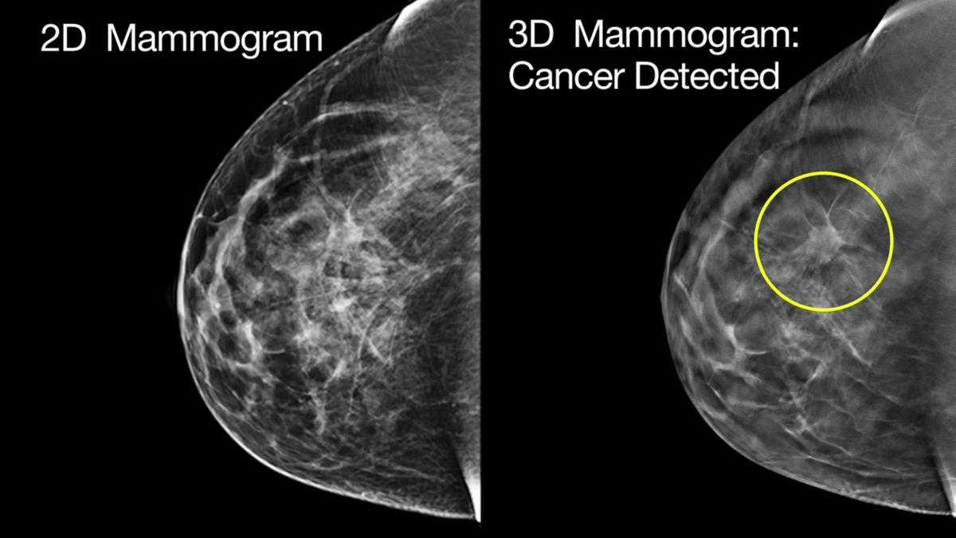
Data
Breast Cancer Wisconsin (Diagnostic) Dataset
Features are computed from a digitized image of a fine needle aspirate (FNA) of a breast mass.

Slide 4
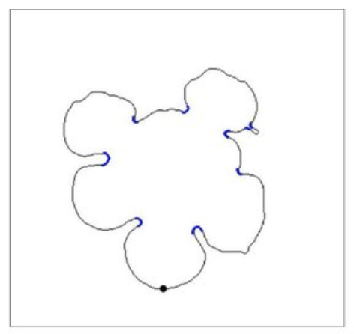
Features
1. radius - mean of distances from center to points on the perimeter
2. texture - standard deviation of gray scale values
3. perimeter
4. area
5. smoothness - Local variation in radius lengths
6. compactness ( = perimeter^2 / area - 1.0)
7. concavity - Severity of concave portions of the contour
8. concave points - Number of concave portions of the contour
9. symmetry
10. fractal dimension (precision of measurement)
The mean, standard error and “worst” or largest (mean of the three largest values) of these features were computed for each image, resulting in 30 features. For instance, field 3 is Mean Radius, field 13 is Radius SE, field 23 is Worst Radius.
Fig: Sample Tumor

Slide 5
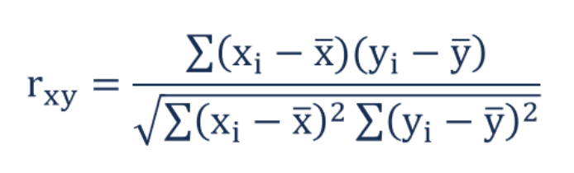
Correlation among features
The correlation between two features x and y is defined by the following formula:

Slide 6
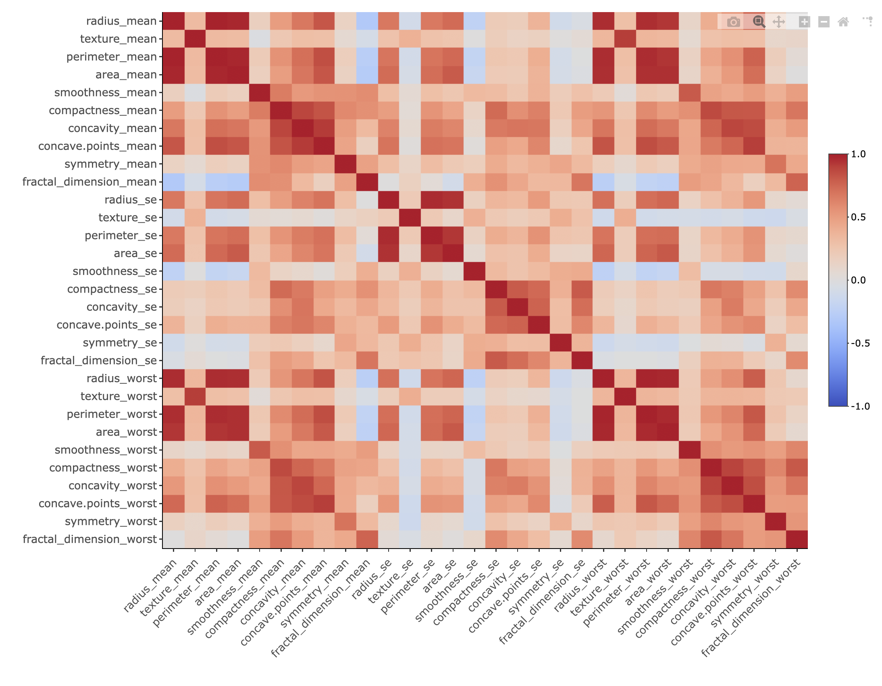
Notes:
Correlation between the 30 features in our data
Mean, se and worst of each feature are co related.
No correlation b/w smoothness and area, peri, radius

Slide 7
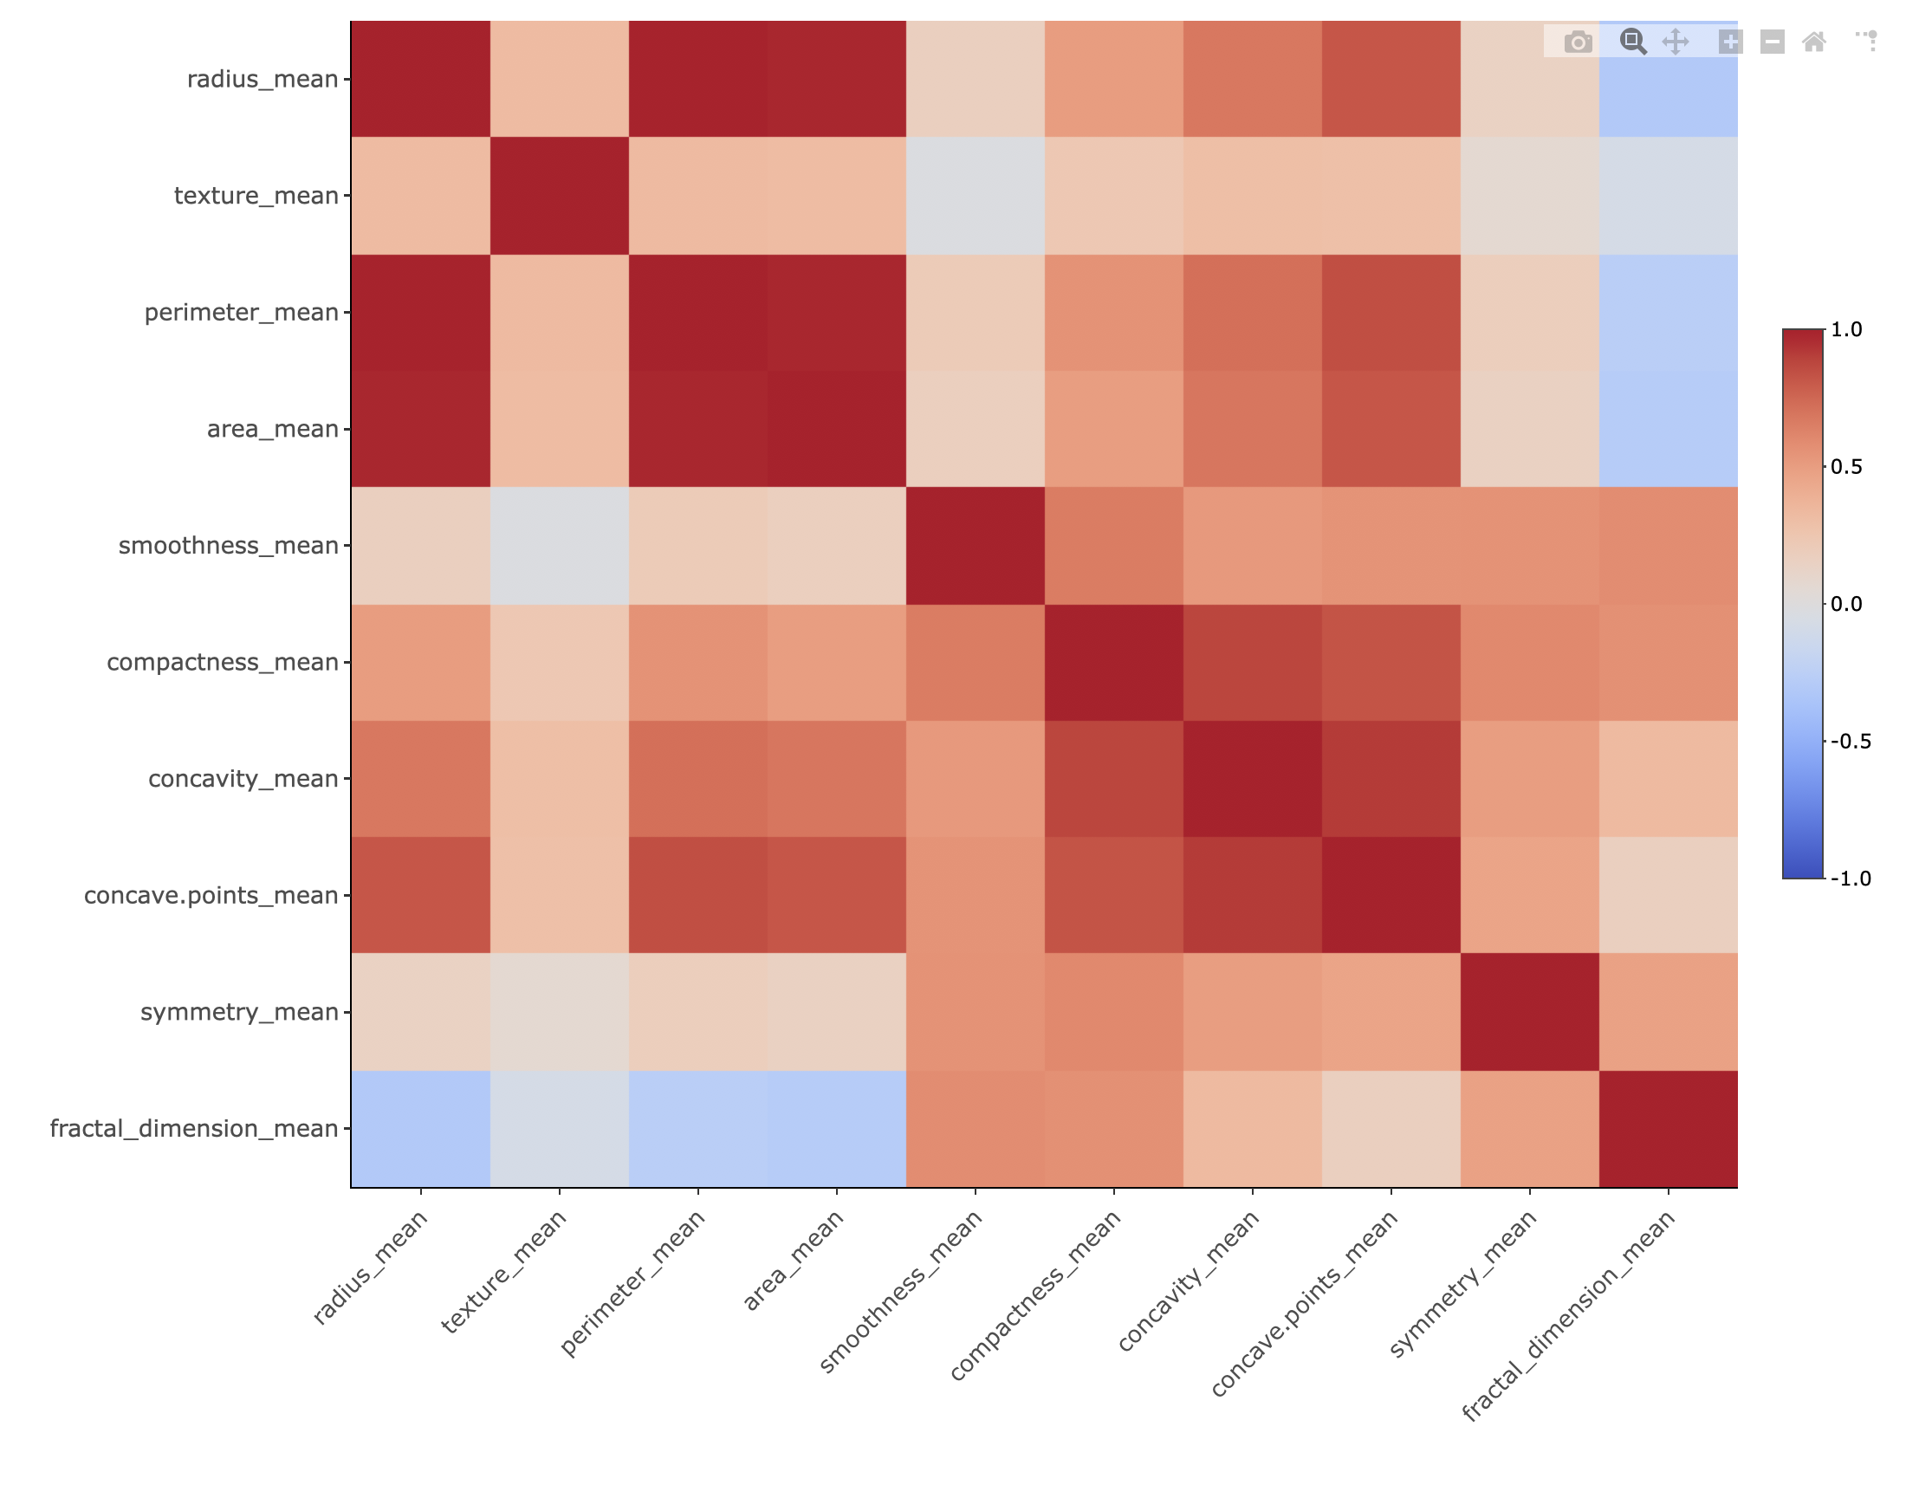
Notes:
Perimeter and Area are highly correlated with radius.
Compactness, concavity and number of concave points are highly correlated.
Fractal, not correlated with area, perimeter, mean
Smoothness, symettry,
No correlation bw smoothness and texture

Slide 8
Principal Component Analysis (PCA)
Linearly combine the features to get new Principal Components which can describe the data with lesser features.
The goal of PCA is to identify directions (or principal components) along which the variation in the data is maximal.
Capture the essence of the data using minimum number of features.

Slide 9
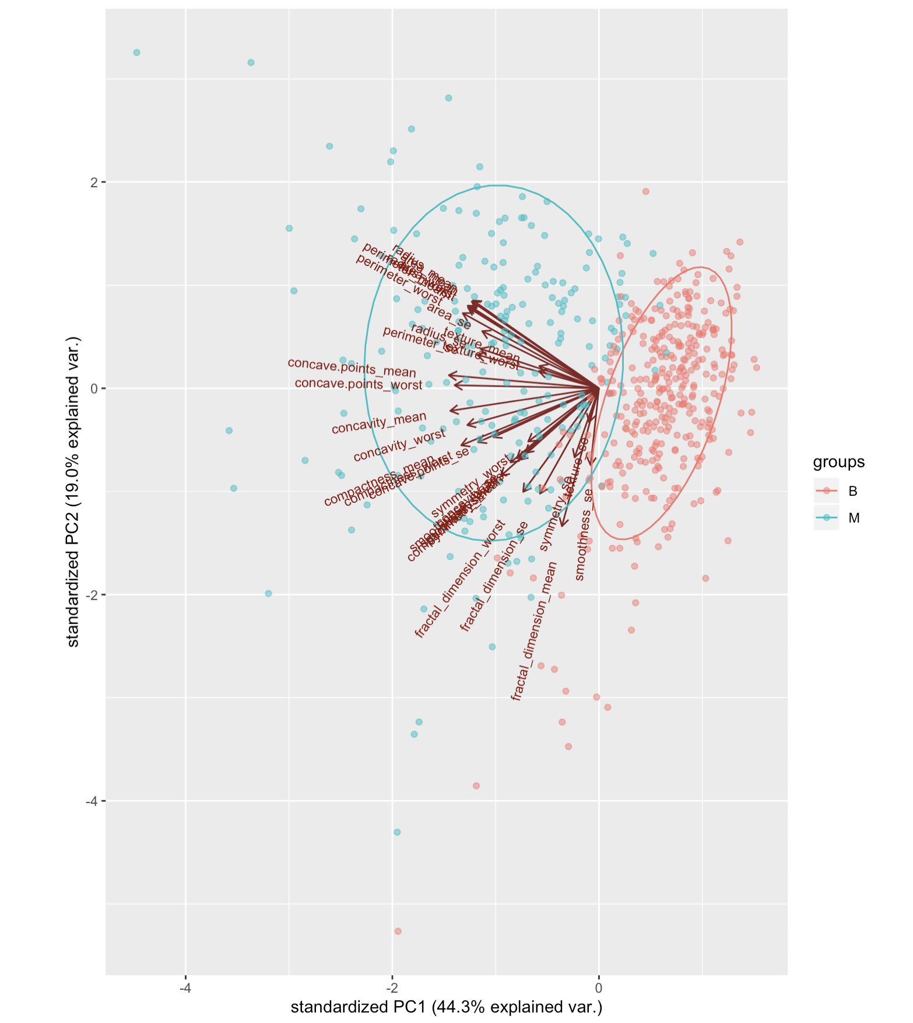
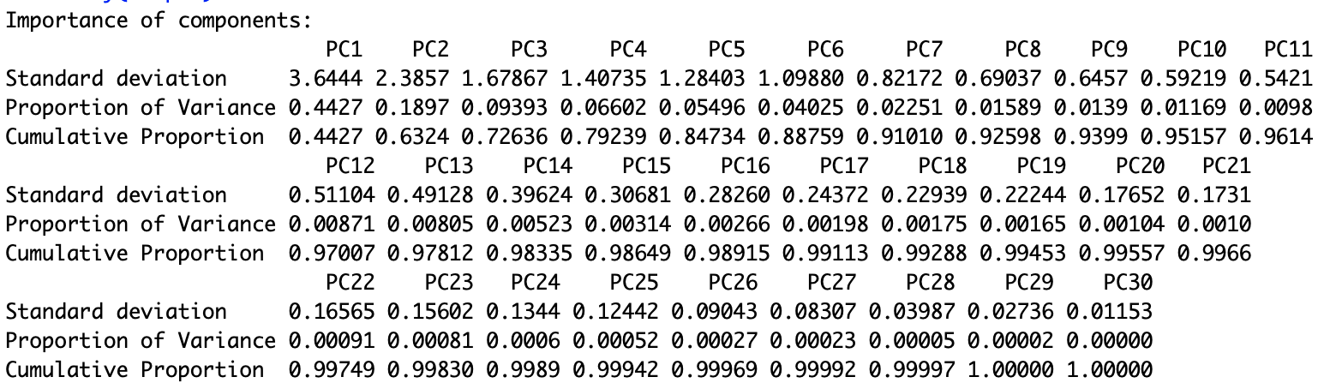
PCA on all
the features

Slide 10
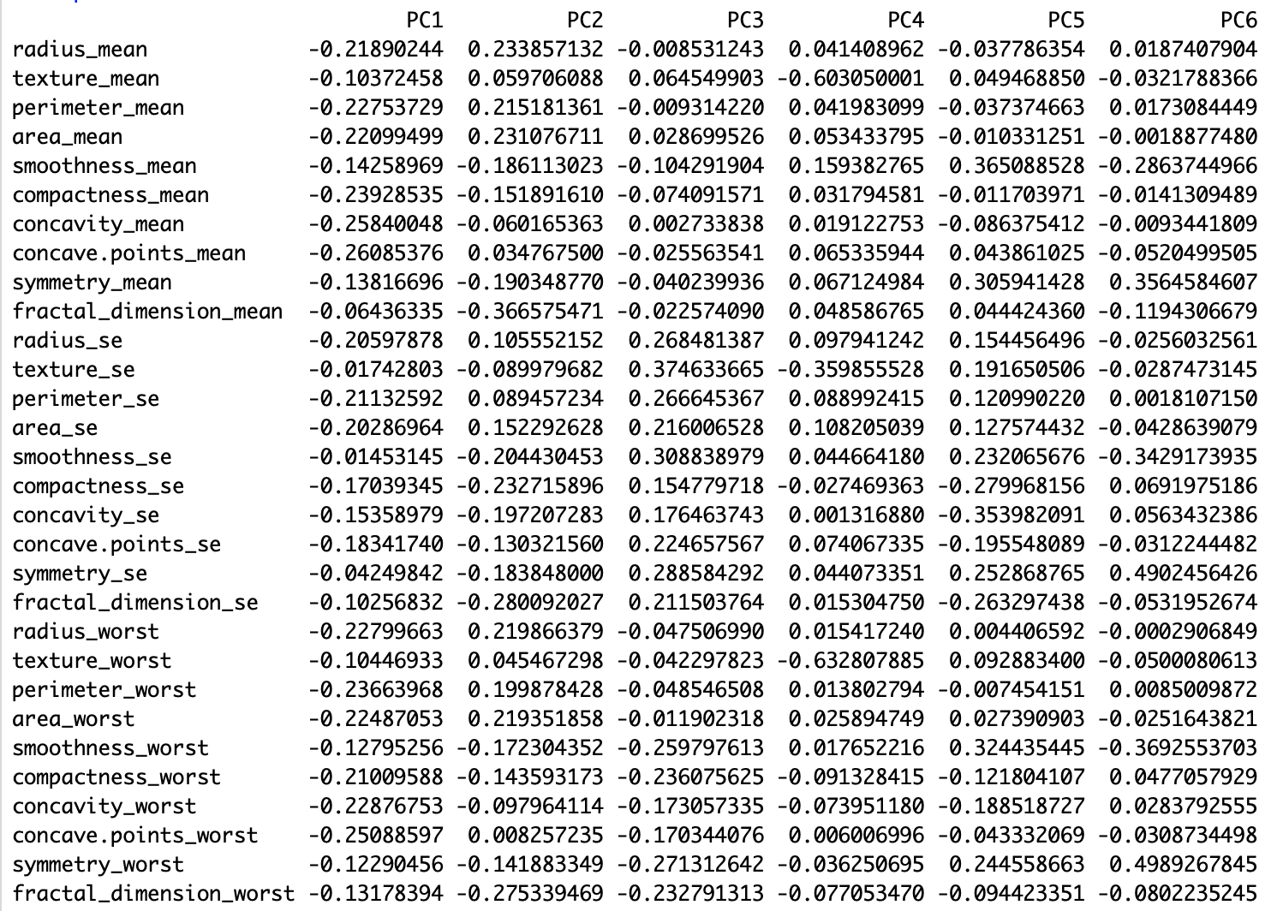
Interpretation of PCA result

Slide 11
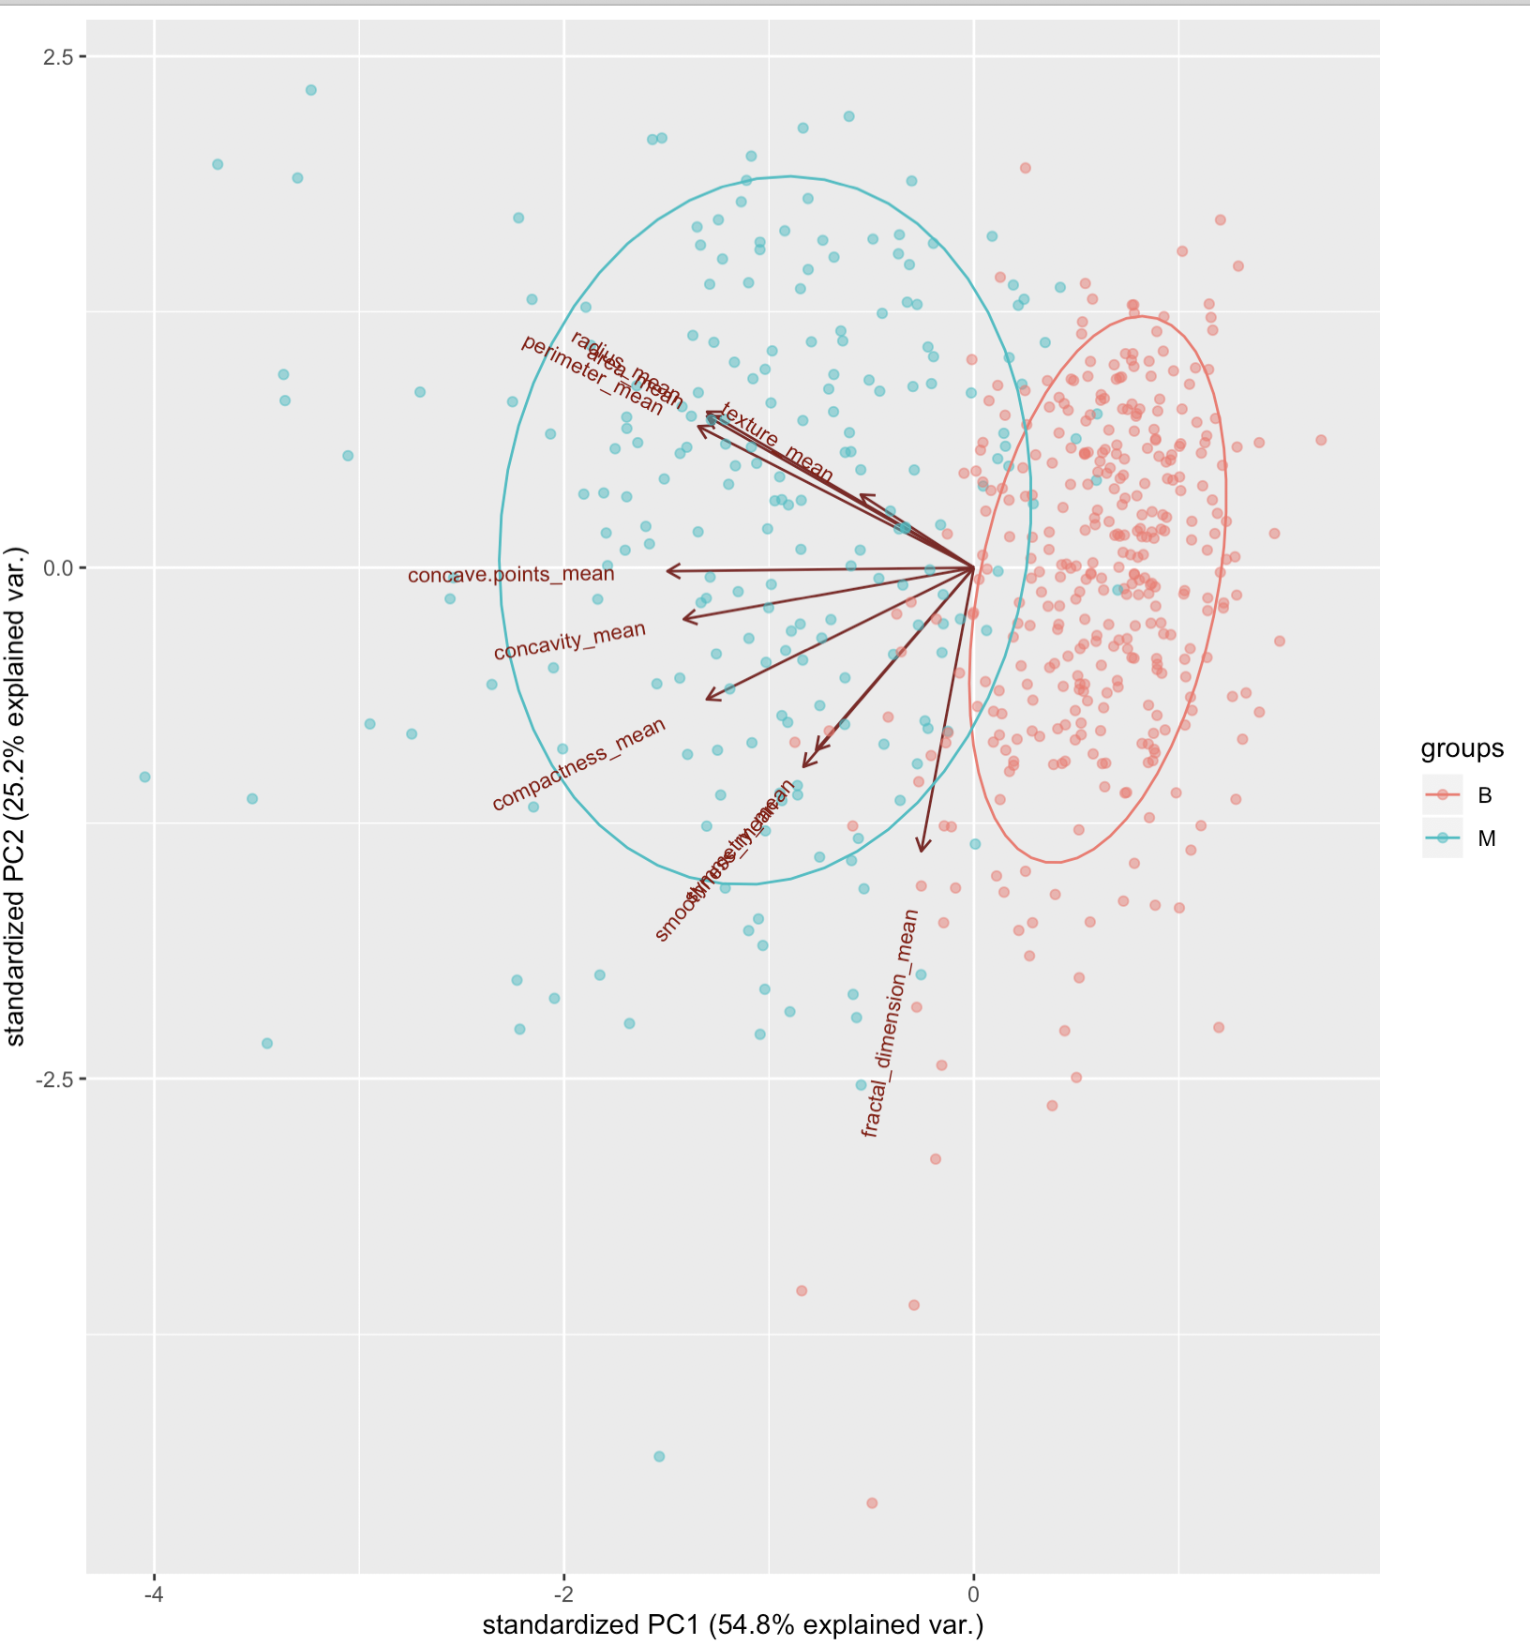
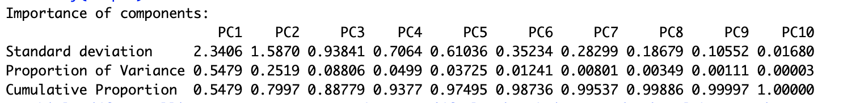
PCA on mean
of the features

Slide 12
Classification methods
Logistic regression
Naive Bayes
Decision trees
Random forest

Slide 13
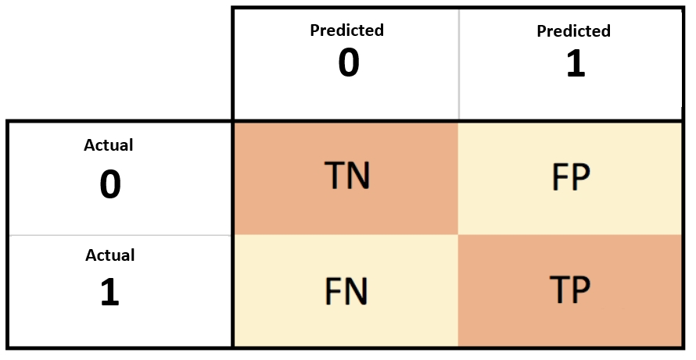
Evaluation of classification methods
Accuracy: Ratio of correct predictions and total predictions
Accuracy = (TN + TP)/ (TN + FP + FN + TP)
Precision: Positive Predictive Value
Precision = TP/ (TP+ FP)
Recall: True Positive Rate or Sensitivity
Recall = TP/ (TP + FN)

Slide 14
Model - Train and Test details
All the results in the upcoming section are computed on the test data after training the model using the training data. We have split the data into train-test data in the ratio of 90%-10%.
Training samples = 512 (90% of the total data)
Testing samples = 57 (10% of the total data)
Also, we have made sure that both training and test have almost equal samples of benign and malignant tumor.

Slide 15
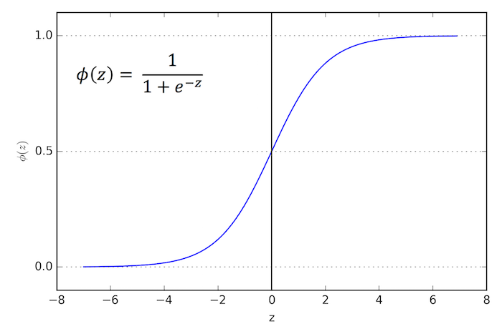
Logistic Regression
The logistic curve is the common ‘S’ shape which takes any real value (-∞ to ∞) and yields output between 0 and 1 depicting the probabilities of belonging to a particular class.
Logistic regression splits the feature space linearly.

Slide 16
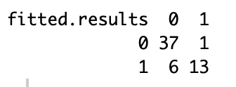
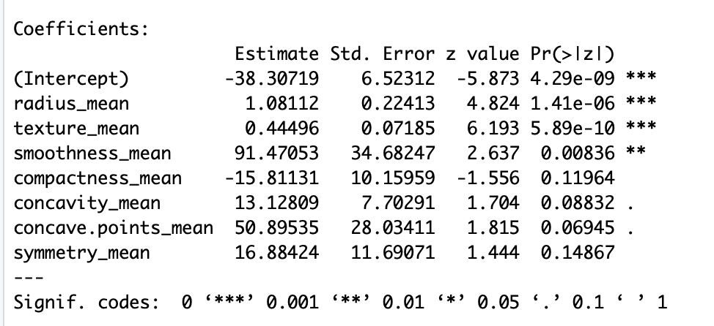
Results
Coefficient table for logistic regression after feature reduction

Slide 17
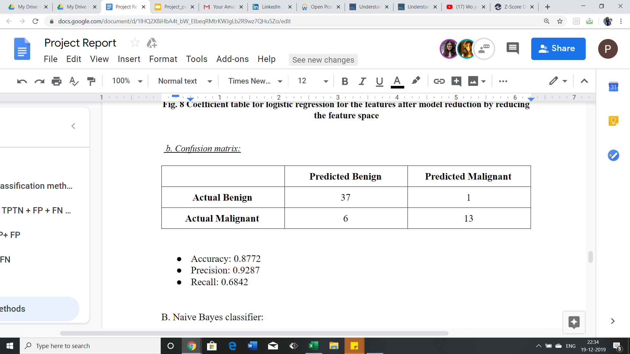
Confusion matrix
Accuracy: 0.8772
Precision: 0.9287
Recall: 0.6842

Slide 18
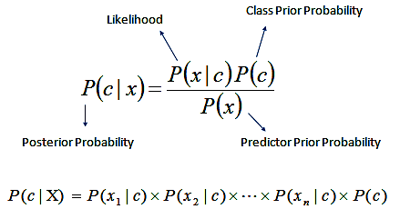
2. Naive Bayes
Classifier based on the Bayes theorem.
Assumption: All the features are independent of one another
Evaluate the posterior probability estimation for each class c, and select the class which has the maximum posterior probability.

Slide 19
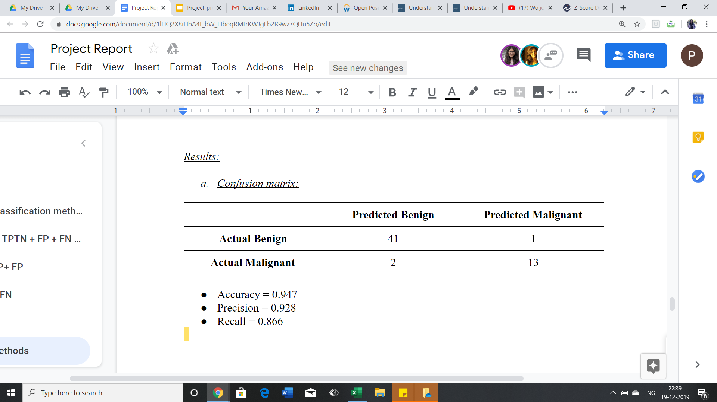
Results
Confusion Matrix:
Accuracy = 0.947
Precision = 0.928
Recall = 0.866

Slide 20
3. Decision Trees
The data is continuously split based according to a certain parameter.
The splitting is done repetitively until the classes are pure i.e. the elements in the class belong to a single class.

Slide 21
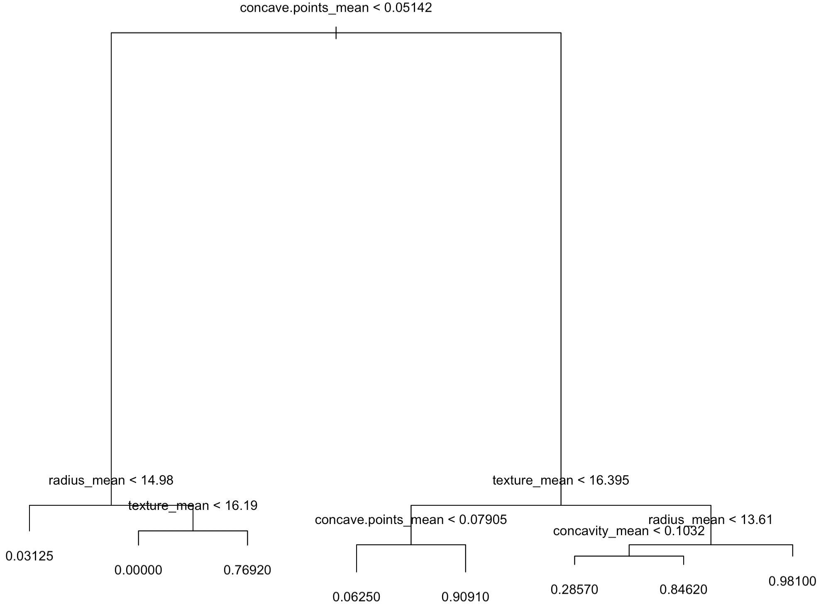
Results
Generated Decision tree:

Slide 22
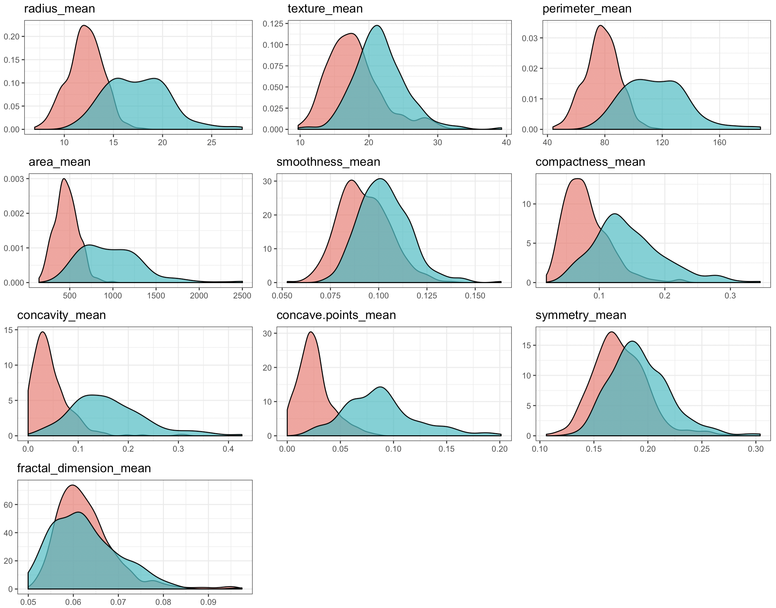
Class wise density of the features
Notes:
Density of each feature, by cancer type
fractal

Slide 23
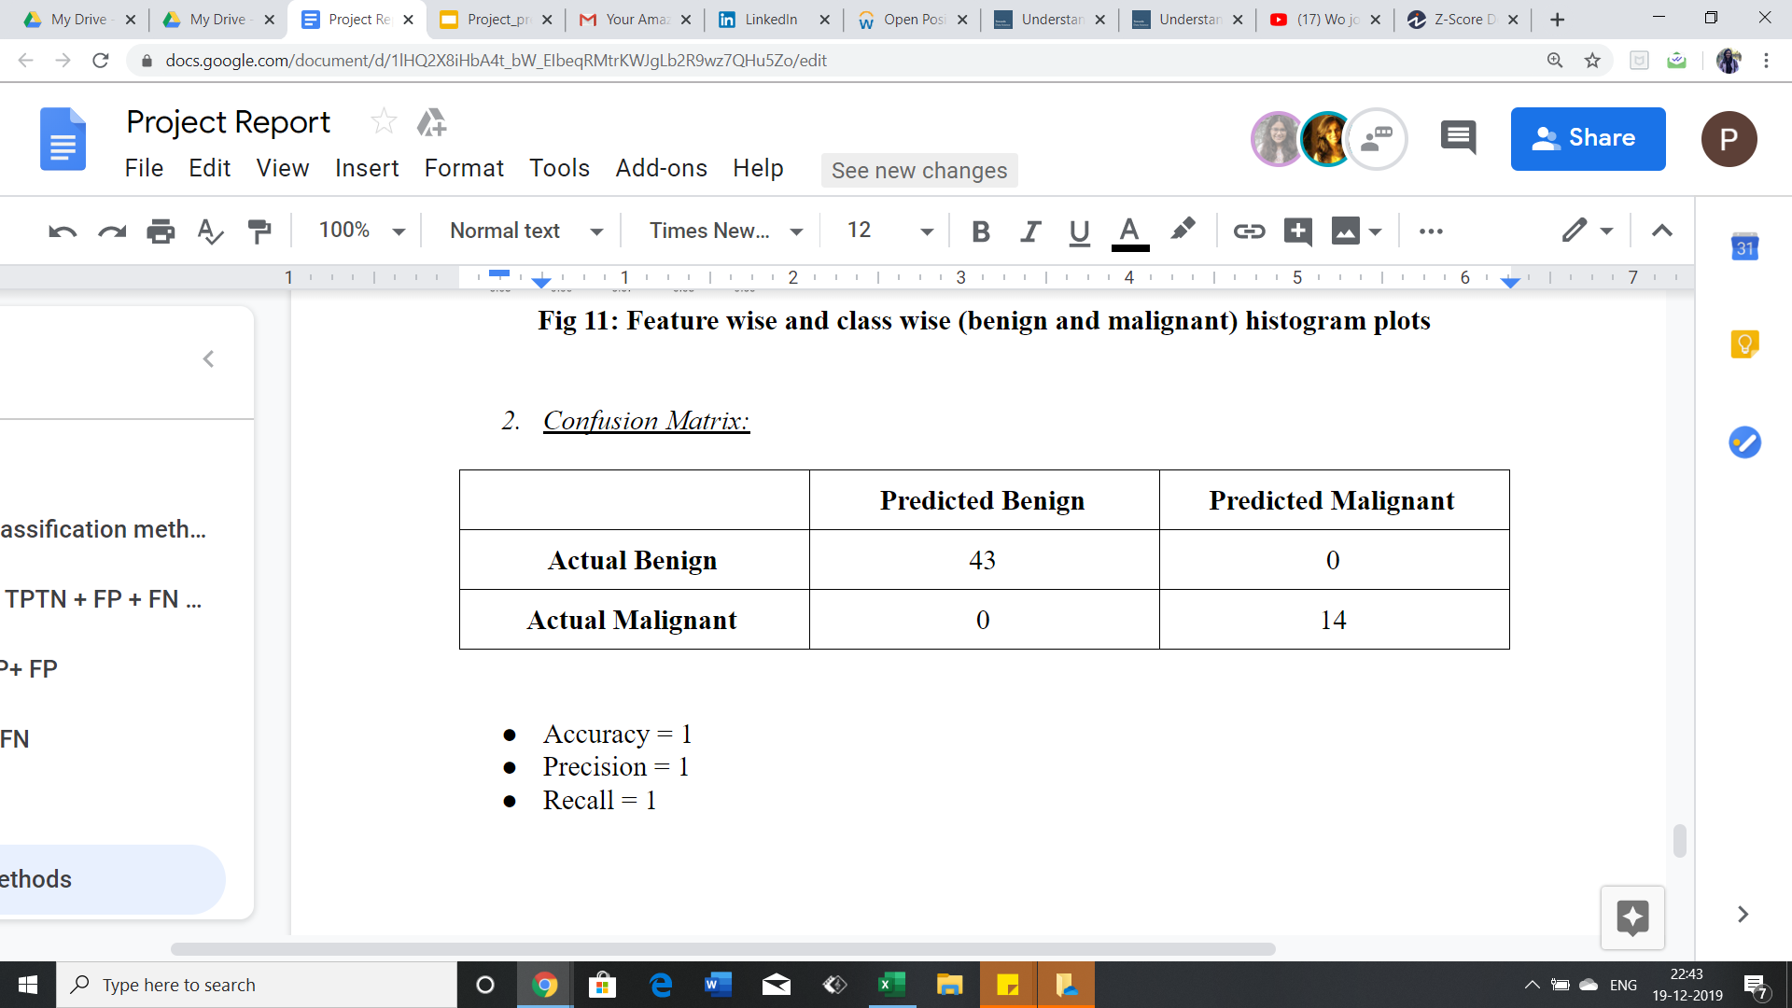
Confusion matrix
Accuracy = 1
Precision = 1
Recall = 1

Slide 24
4. Random Forest
Large number of individual decision trees that operate as an ensemble.
Each individual tree in the random forest produces a prediction of a class and the class with the occurs the most from these predictions is our final model’s prediction.

Slide 25
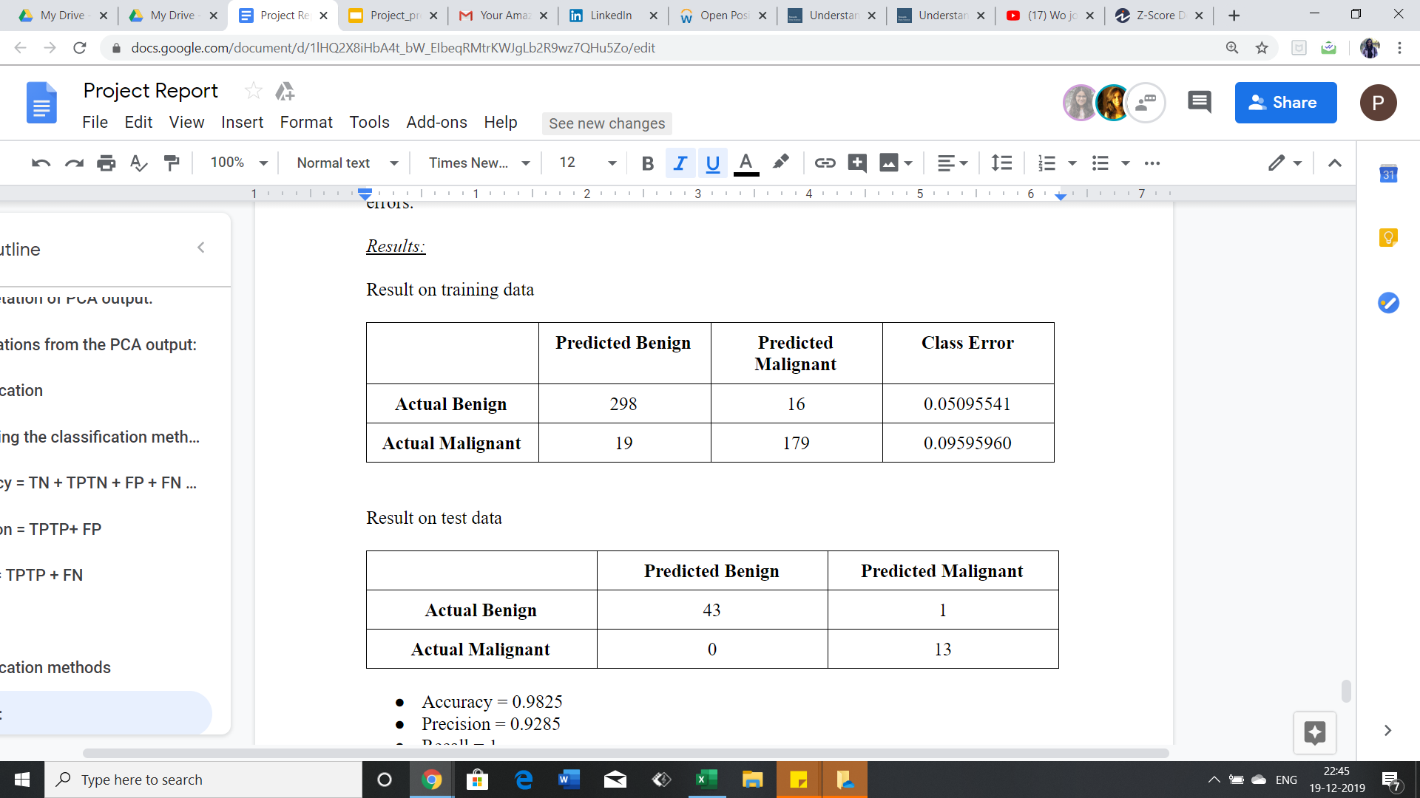
Results
Confusion matrix:
Accuracy = 0.9825
Precision = 0.9285
Recall = 1

Slide 26
Results and Analysis
In our case study of detecting cancer, the main aim is to minimize False-Negative rates. Thus, recall is an important parameter to evaluate our models.
Logistic regression has low recall values as compared to others as it faces the potential drawback of inability to solve nonlinear problems.
Decision trees and Random forests give comparable results. Theoretically, Random forest should give better results than Decision trees. However, in our case, a single decision tree is able to capture the importance of features well.

Slide 27
Learning outcome
Applied concepts of correlation and PCA for feature space reduction.
Classifiers like Naive Bayes which is the direct implication of Bayes rule.
Other supervised learning based classifiers such as Logistic regression, Decision trees and Random forests.
Statistical significance of coefficient estimation in logistic regression using the coefficient table and reducing the feature space based on the table.

Slide 28
References
https://towardsdatascience.com/understanding-random-forest-58381e0602d2
https://towardsdatascience.com/decision-tree-classification-de64fc4d5aac
http://www.sthda.com/english/articles/31-principal-component-methods-in-r-practical-guide/112-pca-principal-component-analysis-essentials/
https://support.minitab.com/en-us/minitab-express/1/help-and-how-to/modeling-statistics/regression/how-to/binary-logistic-regression/interpret-the-results/all-statistics-and-graphs/coefficients/

Slide 29
Acknowledgment
We would like to thank Professor Michael Luvalle for his support and guidance throughout the course and this project.

Slide 30
Thank You

